Slide 1
Picturing the Progressive Era
Sean Pianka and griffin shepherd

Slide 2
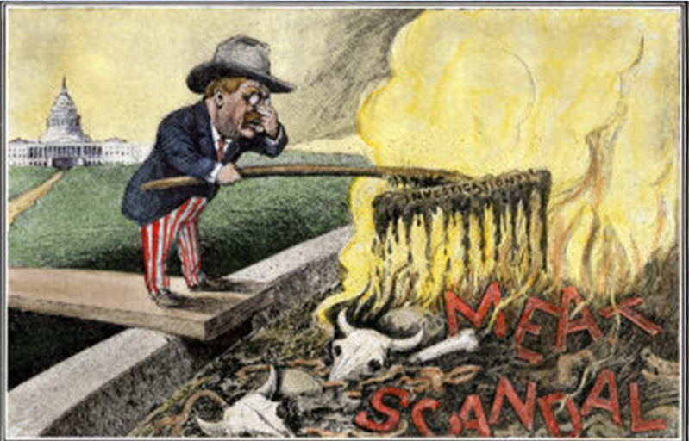
Muckrakers
  Muckrakers had been reform-focused or progressive journalists that had focused on exposing the different points of political, economic, and social corruption of their time. Anything from the horrid working conditions of the factories to an exposed government scandal, the muckrakers worked to uncovered any urban-oriented corruption that was within their power to do so.
  In the attached photo, there is a painting of Theodore Roosevelt with a supposed “muck-rake”(with the words “investigation” written on the front) where he’s attempting to rake out the “meat scandal,” representing the job of the muckrakers during this time, in an attempt to expose it from among the rest of the debris and filth within the pile that seems to scare away others who had attempted to investigate (representing the risk that the muckrakers took and their dedication to doing a job that no one else would do).
  With the advent of the Muckrakers, newspapers would soon transform into a piece not so much based around political party affiliation and subsides, but more so to subscriptions—transforming them into a place more accepting of the Muckrakers exposés and removing their previous role as a political and economic tool for politicians. And with the increasing exposure to their exposés, readers began to often purchase stories surrounding the malpractices of the food and drug industry, the government, the police, the corporations, and the banks. With the increase in exposure and knowledge of these malpractices came the public’s support for legislature providing solutions and removal of the corruption—eventually leading to what the progressive’s thought to be a more orderly society.

Slide 3
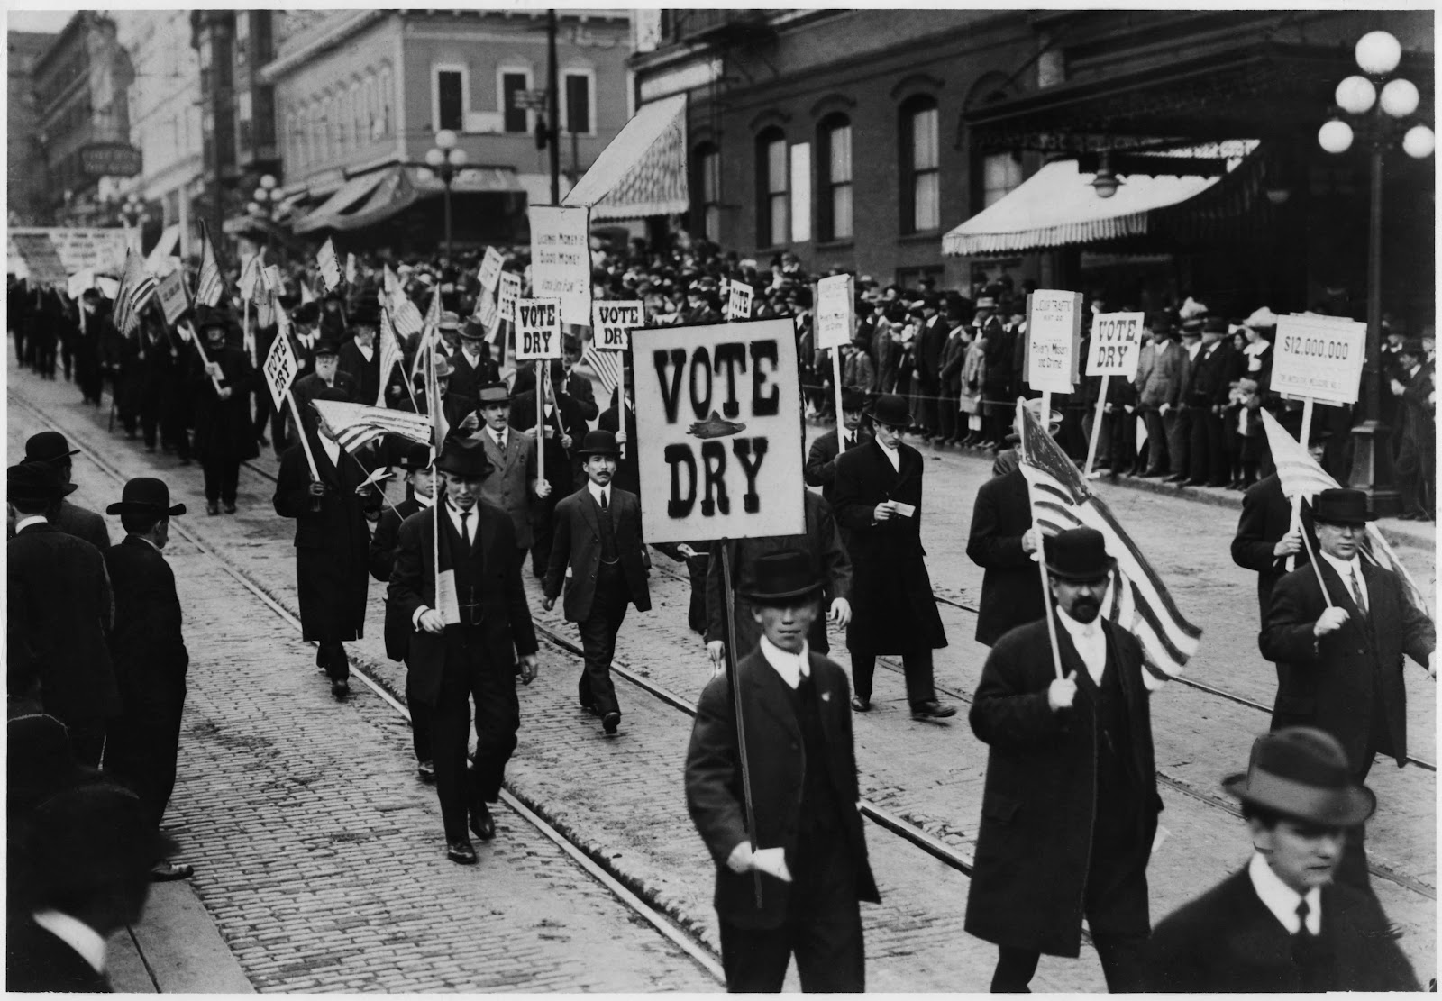
Temperance Movement
The Temperance Movement had been a movement, mainly dominated by women, in an effort to reduce average alcohol consumption of the males of society, often targeted at lower class and immigrants, with the desire to both create a more productive society and a better life for the wives of those who consume too much alcohol (wages being spent on alcohol rather than the family).
The picture on the right shows just one of the main rallies and protests held in support of prohibition (as seen with the “VOTE DRY” signs, they were in favor of the movement). However, this specific rally had been held by the “middle-class” (read: people above the working-class) and demonstrated the widening range of support that prohibition had been gathering over the years since its inception.
This growing level of support (specifically to people with a little more political influence), diverging from the rather concrete group of supports of women and the working-class, helped prohibition gain the momentum it needed to eventually be passed into law as the 18th amendment.

Slide 4
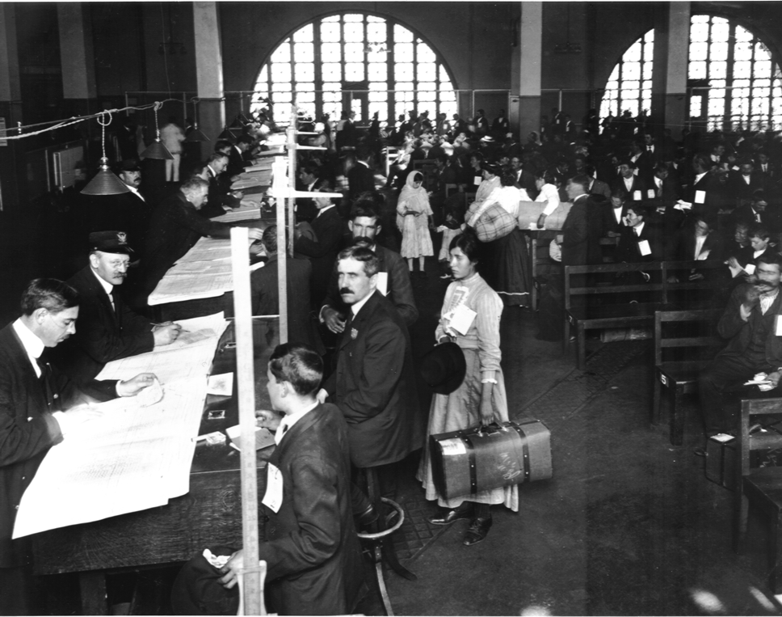
Immigration
Immigration was a very relevant issue during the progressive era. The people were split, some believed that the proper approach was to help immigrants adapt, the others believed that the only solution was to limit the flow of these new citizens. There were many attempts at reform, and one of them was creating sorting offices for immigrants, one of the more known ones being Ellis island, pictured below.
Pictured is Ellis Island, a small island located off of New York city. It was created to sort new immigrants and either approve or deny them for citizenship in the country, and add them to censuses to keep track of them and make them legal.
While there had been some widely varying arguments to support the limitation of immigration, such as the use of eugenics or the effects of “mongrelization,” the key arguments held true to the politicians that with the limitation of immigration would come a solution for such urban problems as overcrowding, unemployment, strained social services, and social unrest.

Slide 5
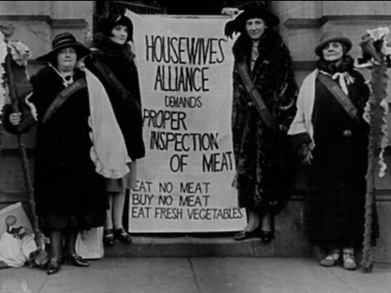
Business Reform
There were many reforms in business that were caused by supporters, and one of the many important reforms was the fight against the inspection-or lack their of-on meat.
In the picture above, it shows a group of women the “Housewives Alliance”, fighting against the lack of inspection of meat in factories. This probably was started by a book “The Jungle” by Upton Sinclair, describing the horrors of the meat packing industry and his experience with it.
Without these movements to force business regulations and inspections, the meat we could be eating could cause disease due to the lack of inspection. It could contain any sort of bacteria that we wouldn’t know about, and it was packaged anyway to save money.

Slide 6
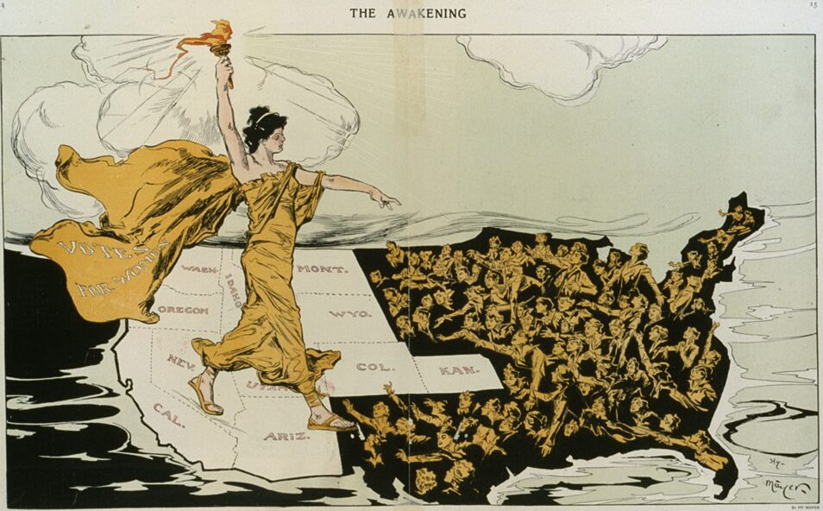
Political Reform
Women were the main leaders of the suffrage movement of the time. Leaders such as Susan B. Anthony pushed the movement for universal suffrage for both women and African Americans.
The picture attached shows a graceful women leader, holding the torch and illuminating the eastern part of the country, showing the women struggling for suffrage there. She is walking over what seems to be a “liberated” west, where their crusades for suffrage were successful.
Today, if these people didn’t exist, and there wasn’t this reform, as a result there wouldn’t be important implications such as the 19th amendment, and prior to that it caused some women to prove themselves and helping out with the war, showing they were just as patriotic as men and deserved suffrage rights.

